Slide 1
ML 실습
(Image classification & Feature extraction)

Slide 2
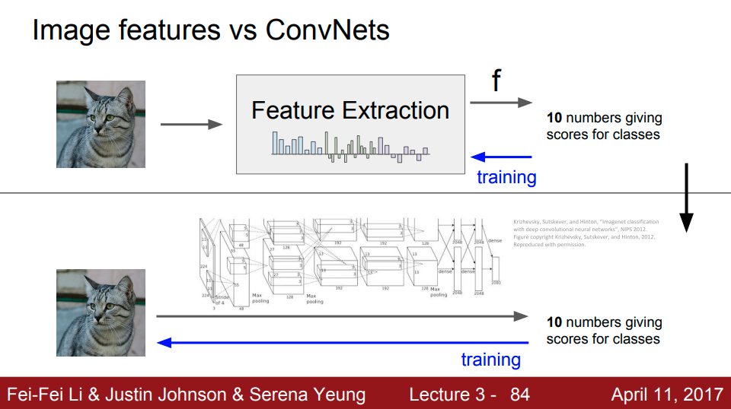

Slide 3
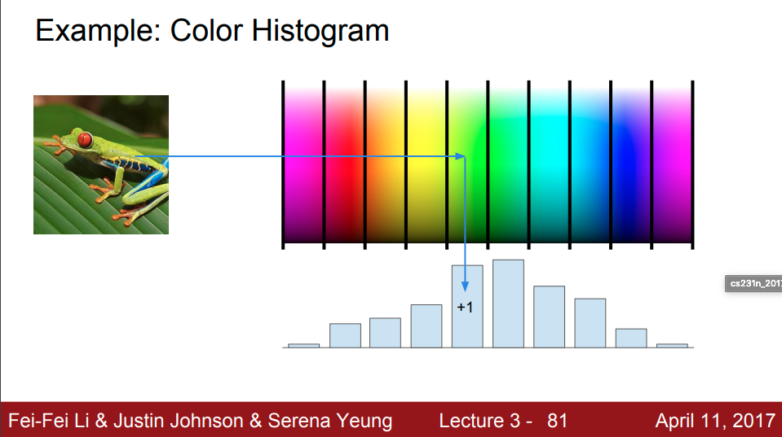
Color histogram
https://gogul.dev/software/image-classification-python

Slide 4
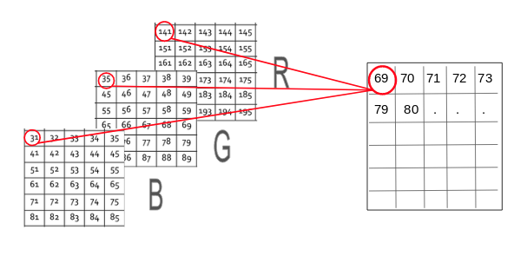
Mean Pixel Value of Channels
https://www.analyticsvidhya.com/blog/2019/08/3-techniques-extract-features-from-image-data-machine-learning-python/

Slide 5

Hu Moments
https://gogul.dev/software/image-classification-python

Slide 6
