Slide 1
2018학년도 하계방학 ZEPPELINX, Inc.인턴십 모집
1. 회사명: ZEPPELINX, Inc. ( https://www.zepl.com/ , https://zeppelin.apache.org/ )
2. 지역: 미국 샌프란시스코 인근
3. 기간: 2018.07.30-08.24 (4 weeks)
4. 인원: 3명 (필요시 4명)
5. 업무:
- Machine Learning Use Case development
- User/usage study
- ZEPL service test
- Manual documentation
6. 지원내역:
- 왕복 항공료 지원
- 미국내 숙박지원 (식비는 각자 본인 자비 부담)
- 해외인턴십 특별학점 전공선택 1학점 인정
7. 지원 및 선발조건
- 지원조건: 컴퓨터소프트웨어공학과/컴퓨터공학과 3-4학년 재학생 들 중 Python 프로그래밍 언어 사용 가능한 자 (AND) 직전학기 평균평점 3.0 이상인 자
- 1차 : Python 기초 프로그래밍 테스트 (array, list를 사용한 기초 프로그래밍, 5.23(수) 오후 5시-6시, 장소는 추후 공지)
- 2차: 면접. 5.29(화) 오후 3:30 (정확한 장소는 추후 공지)
- 이후 최종 선발자는 개별 연락
8. 신청기간: 2018.05.14(월)-18(금) 17시
9. 제출서류: 참가신청서, 성적증명서
10. 제출처 및 문의: 본관 302호 소프트웨어학과 사무실 (041-550-5363)
11. 참고정보 (박희민 교수님 제공)
- ZEPL http://test.zepl.com : "ZeppelinX 에서 만든 서비스입니다. 개발 버전 (test) 이 최근 기능까지 포함되어 있으니 가입해서 사용해보면 좋겠습니다."
- 구글 Colab http://colab.research.google.com : "구글 colab은 비슷한 서비스 중에서 가장 앞서 있는 서비스 같아 보입니다. 참고자료로 많이 사용될 것 같습니다."
- Kaggle : "이건 좀 어려울려나요? :) "

Slide 2
스케쥴 변경 공고 (5.21(월) 예비군 훈련)
원래 스케쥴: 5.21, 5.28, 6.4 오후 6-9시
변경된 스케쥴: 5.28, 6.4, 6.11 오후 6-9시

Slide 3
Data Mining
Practical Machine Learning Tools and Techniques
Slides for Chapter 1, What’s it all about?
of Data Mining by I. H. Witten, E. Frank,
M. A. Hall, and C. J. Pal

Slide 4
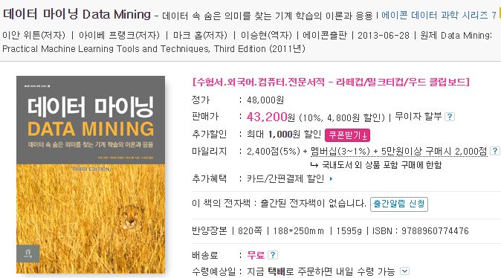

Slide 5
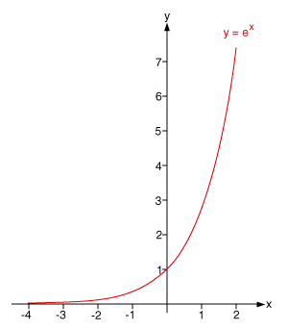
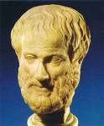
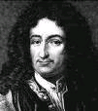
Emergence of New Problem Solving Methodologies (or Why CS is fundamental to almost everything) [Foster 07]
Empirical
Arts and Humanities
Theory
Science
Computer Science &
Engineering
Simulation
Data
Science
Data
<0
1700
1950
1990
Notes:
And…this slide beautifully summarizes all those views and insights in a single picture, in a pretty impressive and informative way.
Since the prehistoric era, people have been solving their problems in an empirical way, based on their experience, observation, real experiments, surroundings, and the results.
And Since the 16th or 17th centuries, renaissance periods, people have adopted theories, primarily math, to solve their problems,
And in the middle of the 20th century, computer was developed by Alan Turing and John von Neumann, then computer simulation has been adopted as a new problem solving methodology, up til now.
And then, finally, in late 20th century, distinguished scientists working at super computer centers, super data centers, connected with high bandwidth networking environment
found that handling and mining massive datasets can also be a new, great methodology, not only for problem solving, but also for searching and identifying exciting new problems.
I saw this slide for the first time while I was staying at San Diego Supercomputer Center back in 2007,
,
Actually this slide changed my career path; from the Internet system engineering to data-driven Internet or social scientist.
SDSC에 있을때 이 slide를 보게 된다….
역사적으로 보면 다음과 같은 흐름을 가지게 된다.
Aristotle, Leibniz, von Neuman, Gray
Theory=math
Simulation = math + CS
Data = bits and algorithms, i.e., CS.
Different disciplines advanced to different stages: e.g., parking still empirical (-:
High speed networks, large-scale data, campus environment, with supercomputing facilities: I was so lucky…

Slide 6
Data 를 이용해서 풀 수 있는 문제들?
Data Mining: the discovery of “models (patterns)” for data.
데이터 속에서 관측되는 패턴을 분석, 모델링 한 후, 원하는 결과를 탐지, 분류 또는 예측 하는 문제들.
“Statisticians view data mining as the construction of a statistical model, that is, an underlying distribution from which the visible data is drawn.”
J. Leskovec et al., Mining of Masive Datasets, 2nd Ed., 2014.

Slide 7
Machine Learning
“The Science (and art) of programming computers so they can learn from data.”
Aurelien Geron, in “Hands on Machine Learning with Scikit-Learn & TensorFlow,” O’Reilly, 2017.
“The field of study that gives computers the ability to learn without being explicitly programmed.”
Arthur Samuel, 1959.

Slide 8
https://chatterbaby.org/pages/
https://www.wired.com/story/can-this-ai-powered-baby-translator-help-diagnose-autism?mbid=social_fb

Slide 9
Chapter 1: What’s it all about?
Data mining and machine learning
Simple examples: the weather problem and others
Fielded applications
The data mining process
Machine learning and statistics
Generalization as search
Data mining and ethics

Slide 10
Information is crucial
Example 1: in vitro fertilization
시험관 아기 시술: 최상의 태아 선택하기?
Given: embryos described by 60 features
Problem: selection of embryos that will survive
Data: historical records of embryos and outcome
Example 2: cow culling
매년 어떤 소를 무리에 계속 남게 할지, 아니면 도축장으로 보낼지?
Given: cows described by 700 features
Problem: selection of cows that should be culled
Data: historical records and farmers’ decisions

Slide 11
From data to information
Society produces huge amounts of data
Sources: business, science, medicine, economics, geography, environment, sports, …
This data is a potentially valuable resource
Raw data is useless: need techniques to automatically extract information from it
Data: recorded facts
Information: patterns underlying the data
We are concerned with machine learning techniques for automatically finding patterns in data
Patterns that are found may be represented as structural descriptions or as black-box models

Slide 12
Structural descriptions
Example: if-then rules (어떤 콘택트 렌즈를 추천할 것인가?)
If tear production rate(눈물분비율) = reduced (줄어듬) then recommendation = none
Otherwise, if age = young and astigmatic(난시) = no then recommendation = soft (소프트 렌즈)
Age
Spectacle prescr-iption(근시/원시)
Astigmatism
(난시 여부)
Tear production rate(눈물분비율)
Recommended lenses
Young
Myope(근시)
No
Reduced
None
Young
Hypermetrope(원시)
No
Normal
Soft
Pre-presbyopic
Hypermetrope
No
Reduced
None
Presbyopic(노안)
Myope
Yes
Normal
Hard
…
…
…
…
…

Slide 13
Machine learning
Definitions of “learning” from dictionary:
To get knowledge of by study, experience, or being taught
To become aware by information or from observation
To commit to memory
To be informed of, ascertain; to receive instruction
Difficult to measure
Trivial for computers
Operational definition:
Things learn when they change their behavior in a way that makes them perform better in the future.
Does a slipper learn?
Does learning imply intention?

Slide 14
Data mining
Finding patterns in data that provide insight or enable fast and accurate decision making
Strong, accurate patterns are needed to make decisions
Problem 1: most patterns are not interesting
Problem 2: patterns may be inexact (or spurious)
Problem 3: data may be garbled or missing
Machine learning techniques identify patterns in data and provide many tools for data mining
Of primary interest are machine learning techniques that provide structural descriptions

Slide 15
Example: generating a rule
If true then class = a
If x > 1.2 and y > 2.6 then class = a
If x > 1.2 then class = a
Possible rule set for class “b”:
Could add more rules, get “perfect” rule set
If x ≤ 1.2 then class = b
If x > 1.2 and y ≤ 2.6 then class = b

Slide 16
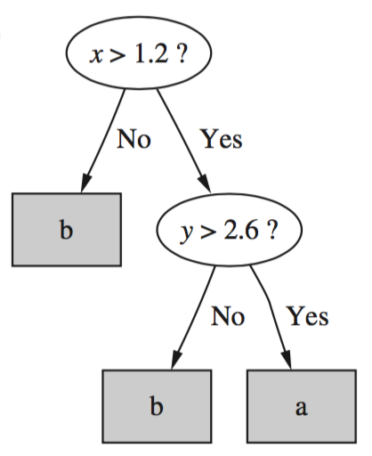
Corresponding decision tree:
(produces exactly the same
predictions)

Slide 17
The weather problem
Conditions for playing a certain game
Outlook
Temperature
Humidity
Windy
Play
Sunny
Hot
High
False
No
Sunny
Hot
High
True
No
Overcast
Hot
High
False
Yes
Rainy
Mild
Normal
False
Yes
…
…
…
…
…
If outlook = sunny and humidity = high then play = no
If outlook = rainy and windy = true then play = no
If outlook = overcast then play = yes
If humidity = normal then play = yes
If none of the above then play = yes

Slide 18
Classification vs. association rules
Classification rule: predicts value of a given attribute (the classification of an example)
Association rule: predicts value of arbitrary attribute (or combination)
If outlook = sunny and humidity = high then play = no
If temperature = cool then humidity = normal
If humidity = normal and windy = false then play = yes
If outlook = sunny and play = no then humidity = high
If windy = false and play = no then outlook = sunny and humidity = high

Slide 19
Weather data with mixed attributes
Some attributes have numeric values
Outlook
Temperature
Humidity
Windy
Play
Sunny
85
85
False
No
Sunny
80
90
True
No
Overcast
83
86
False
Yes
Rainy
75
80
False
Yes
…
…
…
…
…
If outlook = sunny and humidity > 83 then play = no
If outlook = rainy and windy = true then play = no
If outlook = overcast then play = yes
If humidity < 85 then play = yes
If none of the above then play = yes

Slide 20
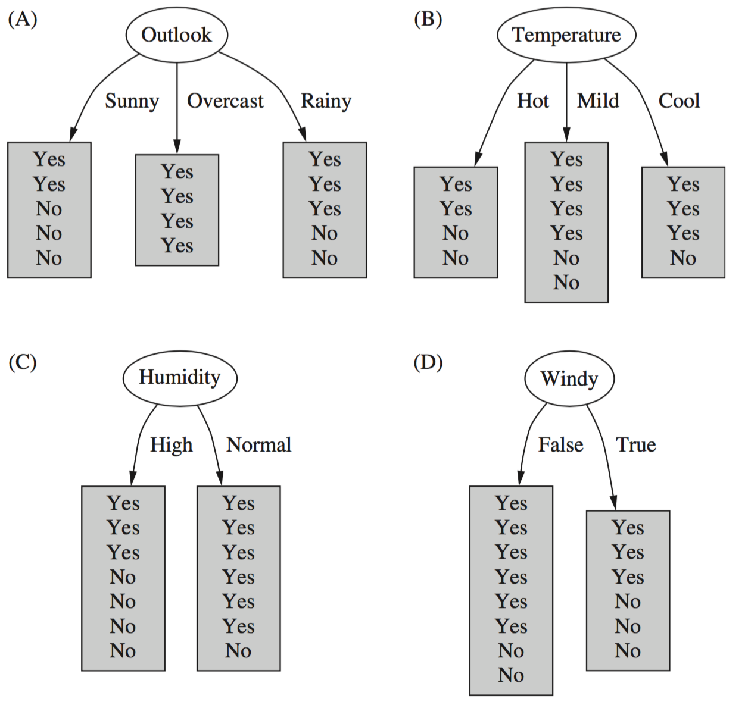
Which attribute to select?

Slide 21
Which attribute to select?

Slide 22
The contact lenses data
Age
Spectacle prescription (근시/원시)
Astigmatism (난시여부)
Tear production rate (눈물분비율)
Recommended lenses
Young
Myope (근시)
No
Reduced
None
Young
Myope
No
Normal
Soft
Young
Myope
Yes
Reduced
None
Young
Myope
Yes
Normal
Hard
Young
Hypermetrope (원시)
No
Reduced
None
Young
Hypermetrope
No
Normal
Soft
Young
Hypermetrope
Yes
Reduced
None
Young
Hypermetrope
Yes
Normal
hard
Pre-presbyopic (노안 전)
Myope
No
Reduced
None
Pre-presbyopic
Myope
No
Normal
Soft
Pre-presbyopic
Myope
Yes
Reduced
None
Pre-presbyopic
Myope
Yes
Normal
Hard
Pre-presbyopic
Hypermetrope
No
Reduced
None
Pre-presbyopic
Hypermetrope
No
Normal
Soft
Pre-presbyopic
Hypermetrope
Yes
Reduced
None
Pre-presbyopic
Hypermetrope
Yes
Normal
None
Presbyopic (노안)
Myope
No
Reduced
None
Presbyopic
Myope
No
Normal
None
Presbyopic
Myope
Yes
Reduced
None
Presbyopic
Myope
Yes
Normal
Hard
Presbyopic
Hypermetrope
No
Reduced
None
Presbyopic
Hypermetrope
No
Normal
Soft
Presbyopic
Hypermetrope
Yes
Reduced
None
Presbyopic
Hypermetrope
Yes
Normal
None

Slide 23
A complete and correct rule set
If tear production rate = reduced then recommendation = none
If age = young and astigmatic = no and tear production rate = normal then recommendation = soft
If age = pre-presbyopic and astigmatic = no and tear production rate = normal then recommendation = soft
If age = presbyopic and spectacle prescription = myope and astigmatic = no then recommendation = none
If spectacle prescription = hypermetrope and astigmatic = no and tear production rate = normal then recommendation = soft
If spectacle prescription = myope and astigmatic = yes and tear production rate = normal then recommendation = hard
If age young and astigmatic = yes and tear production rate = normal then recommendation = hard
If age = pre-presbyopic and spectacle prescription = hypermetrope and astigmatic = yes then recommendation = none
If age = presbyopic and spectacle prescription = hypermetrope and astigmatic = yes then recommendation = none

Slide 24
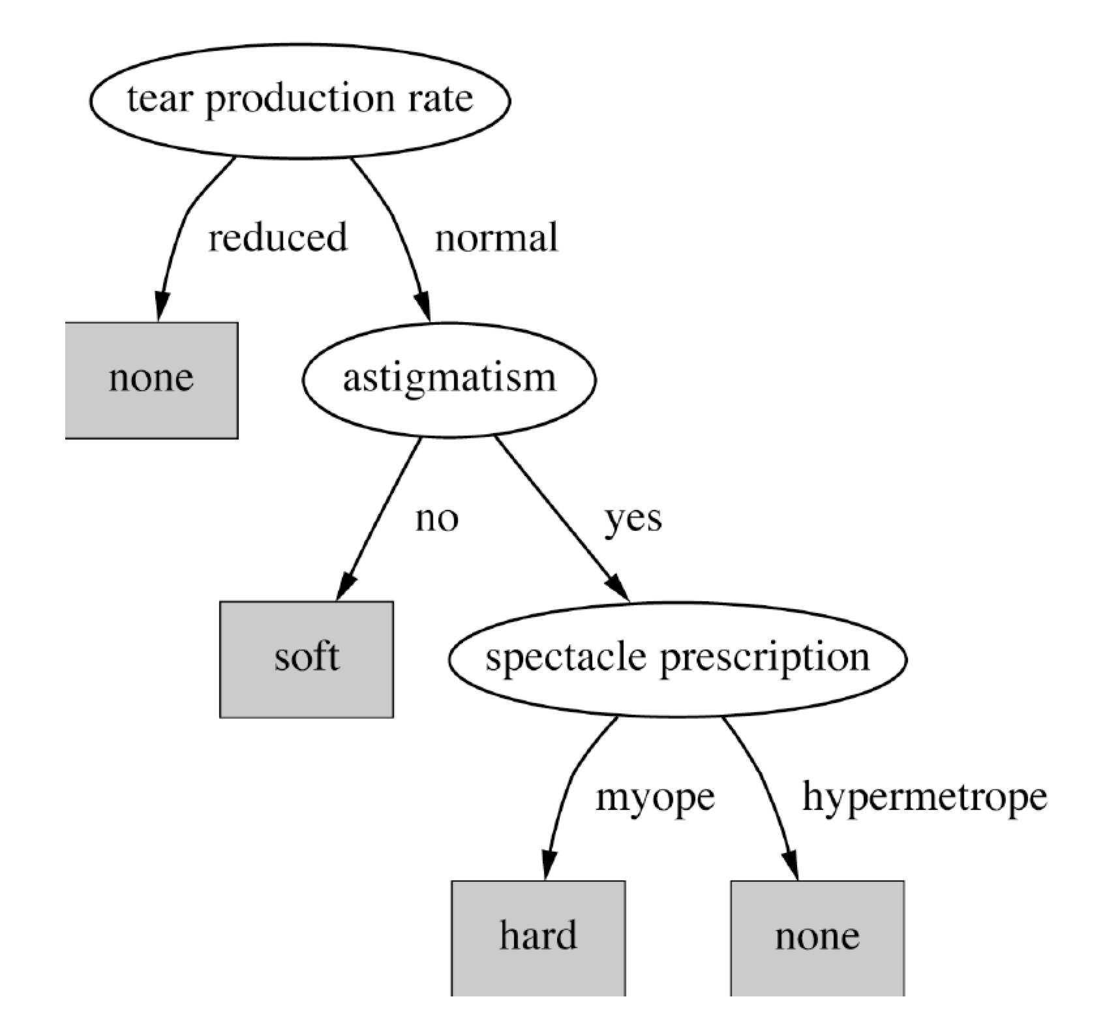
A decision tree for this problem
눈물분비율
난시여부
근/원시

Slide 25
Classifying iris flowers (카테고리 예측, pp. 59)
Sepal length
(꽃받침 길이)
Sepal width (꽃받침 폭)
Petal length (꽃잎 길이)
Petal width
(꽃잎 폭)
Type
1
5.1
3.5
1.4
0.2
Iris setosa (부채붓꽃)
2
4.9
3.0
1.4
0.2
Iris setosa
…
51
7.0
3.2
4.7
1.4
Iris versicolor (붓꽃)
52
6.4
3.2
4.5
1.5
Iris versicolor
…
101
6.3
3.3
6.0
2.5
Iris virginica (북미산 붓꽃)
102
5.8
2.7
5.1
1.9
Iris virginica
…
If petal length(꽃잎 길이) < 2.45 then Iris setosa(부채붓꽃)
If sepal width(꽃받침 폭) < 2.10 then Iris versicolor(북미산붓꽃)
...

Slide 26
Predicting CPU performance (수치값 예측)
Example: 209 different computer configurations
Linear regression function (선형 회귀 방정식)
Cycle time (ns)
Main memory (Kb)
Cache (Kb)
Channels
Performance
MYCT
MMIN
MMAX
CACH
CHMIN
CHMAX
PRP
1
125
256
6000
256
16
128
198
2
29
8000
32000
32
8
32
269
…
208
480
512
8000
32
0
0
67
209
480
1000
4000
0
0
0
45
PRP = -55.9 + 0.0489 MYCT + 0.0153 MMIN + 0.0056 MMAX + 0.6410 CACH - 0.2700 CHMIN + 1.480 CHMAX

Slide 27
Data from labor negotiations (노조 협상, pp. 62)
Attribute
Type
1
2
3
…
40
Duration
(Number of years)
1
2
3
2
Wage increase first year
Percentage
2%
4%
4.3%
4.5
Wage increase second year
Percentage
?
5%
4.4%
4.0
Wage increase third year
Percentage
?
?
?
?
Cost of living adjustment
{none,tcf,tc}
none
tcf
?
none
Working hours per week
(Number of hours)
28
35
38
40
Pension
{none,ret-allw, empl-cntr}
none
?
?
?
Standby pay
Percentage
?
13%
?
?
Shift-work supplement
Percentage
?
5%
4%
4
Education allowance
{yes,no}
yes
?
?
?
Statutory holidays
(Number of days)
11
15
12
12
Vacation
{below-avg,avg,gen}
avg
gen
gen
avg
Long-term disability assistance
{yes,no}
no
?
?
yes
Dental plan contribution
{none,half,full}
none
?
full
full
Bereavement assistance
{yes,no}
no
?
?
yes
Health plan contribution
{none,half,full}
none
?
full
half
Acceptability of contract
{good,bad}
bad
good
good
good

Slide 28
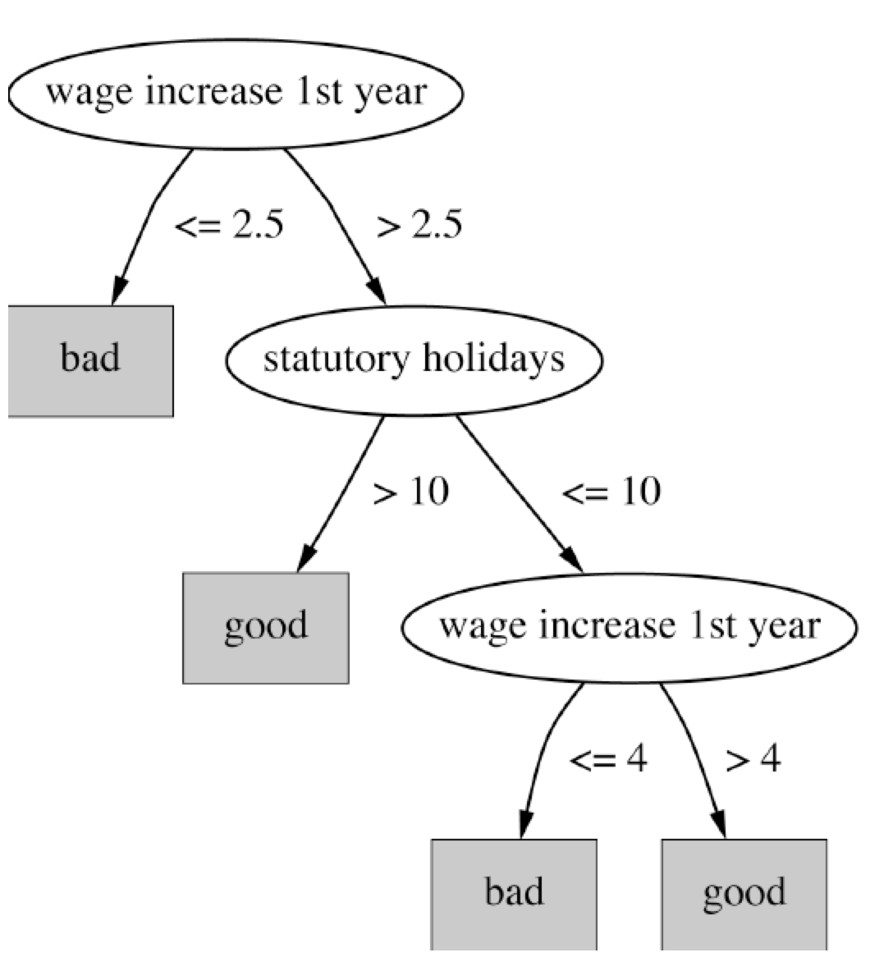
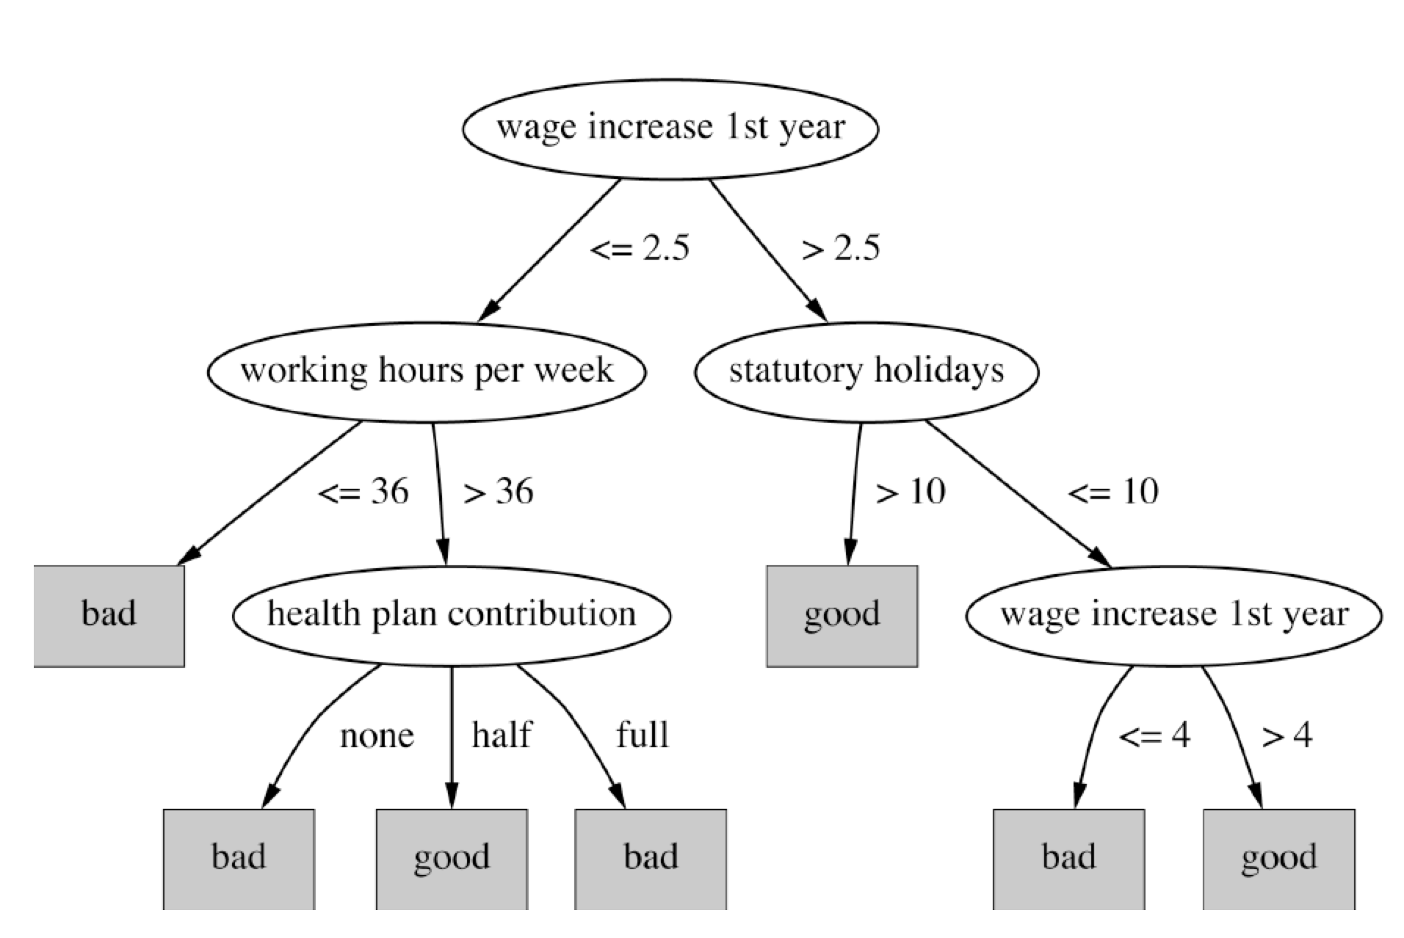
Decision trees for the labor data
법정공휴일
법정공휴일

Slide 29
Soybean classification (콩의 질병 진단 규칙 사례, pp.65)
Attribute
Number of values
Sample value
Environment
Time of occurrence
7
July
Precipitation
3
Above normal
…
Seed
Condition
2
Normal
Mold growth
2
Absent
…
Fruit
Condition of fruit pods
4
Normal
Fruit spots
5
?
Leaf
Condition
2
Abnormal
Leaf spot size
3
?
…
Stem
Condition
2
Abnormal
Stem lodging
2
Yes
…
Root
Condition
3
Normal
Diagnosis
(진단명)
19
Diaporthe stem canker (검은점 무늬 화부병)

Slide 30
The role of domain knowledge
If leaf condition is normal and stem condition is abnormal and stem cankers (줄기 궤양) is below soil line and canker lesion color is brown
then diagnosis is rhizoctonia root rot (무 잎마름병)
If leaf malformation(잎 기형) is absent and stem condition is abnormal and stem cankers (줄기 궤양) is below soil line and canker lesion color is brown
then diagnosis is rhizoctonia root rot (무 잎마름병)
But in this domain, “leaf condition is normal” implies “leaf malformation is absent”!

Slide 31
Fielded applications
The result of learning—or the learning method itself—is deployed in practical applications
Processing loan applications
Screening images for oil slicks
Electricity supply forecasting
Diagnosis of machine faults
Marketing and sales
Separating crude oil and natural gas
Reducing banding in rotogravure printing (윤전 프린팅 시스템)
Finding appropriate technicians for telephone faults
Scientific applications: biology, astronomy, chemistry
Automatic selection of TV programs
Monitoring intensive care patients

Slide 32
Processing loan applications (American Express)
Given: questionnaire with financial and personal information
Question: should money be lent?
Simple statistical method covers 90% of cases
Borderline cases referred to loan officers
But: 50% of accepted borderline cases defaulted!
Solution: reject all borderline cases?
No! Borderline cases are most active customers

Slide 33
Enter machine learning
1000 training examples of borderline cases
20 attributes:
age
years with current employer
years at current address
years with the bank
other credit cards possessed,…
Learned rules: correct on 70% of cases
human experts only 50%
Rules could be used to explain decisions to customers

Slide 34
크라우드 펀딩 Scam detection
일본산 소고기 육포 고기
2013. 5. 15 ~ 2013. 6. 14 (30 days)
3,252 명
$120,309
Funding Suspended
아틀란틱 시티 보드 게임
2012. 5. 7 ~ 2012. 6. 6(30 days)
1,246명
$122,874
Successfully funded
최초로 미국에서 법적으로 처벌 받은 프로젝트

Slide 35
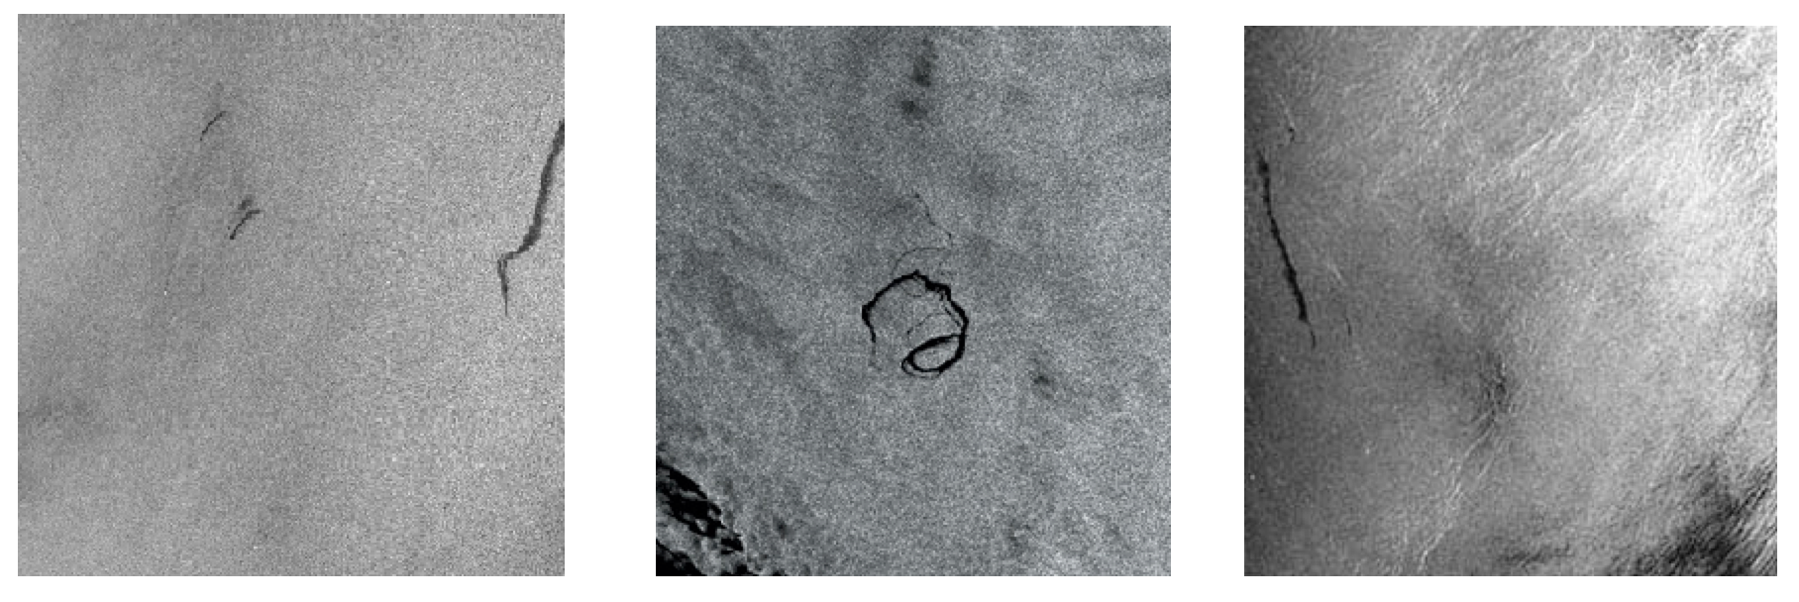
Screening images
Given: radar satellite images of coastal waters
Problem: detect oil slicks in those images
Oil slicks appear as dark regions with changing size and shape
Not easy: lookalike dark regions can be caused by weather conditions (e.g. high wind)
Expensive process requiring highly trained personnel

Slide 36
Enter machine learning
Extract dark regions from normalized image
Attributes:
size of region
shape, area
intensity
sharpness and jaggedness (거칢) of boundaries
proximity of other regions
info about background
Constraints:
Few training examples—oil slicks are rare!
Unbalanced data: most dark regions aren’t slicks
Regions from same image form a batch
Requirement: adjustable false-alarm rate

Slide 37
Load forecasting (pp.72)
Electricity supply companies need forecast of future demand for power
Forecasts of min/max load for each hour => significant savings
Given: manually constructed load model that assumes “normal” climatic conditions
Problem: adjust for weather conditions
Static model consist of:
base load for the year
load periodicity over the year
effect of holidays

Slide 38
Enter machine learning
Prediction corrected using “most similar” days
Attributes:
temperature
humidity
wind speed
cloud cover readings
plus difference between actual load and predicted load
Average difference among three “most similar” days added to static model
Linear regression coefficients form attribute weights in similarity function

Slide 39
Diagnosis of machine faults
Diagnosis: classical domain of expert systems
Given: Fourier analysis of vibrations measured at various points of a device’s mounting
Question: which fault is present?
Preventative maintenance of electromechanical motors and generators
Information very noisy
So far: diagnosis by expert/hand-crafted rules
Notes:
39

Slide 40
Enter machine learning
Available: 600 faults with expert’s diagnosis
~300 unsatisfactory, rest used for training
Attributes augmented by intermediate concepts that embodied causal domain knowledge
Expert not satisfied with initial rules because they did not relate to his domain knowledge
Further background knowledge resulted in more complex rules that were satisfactory
Learned rules outperformed hand-crafted ones

Slide 41
Marketing and sales I (pp. 74)
Companies precisely record massive amounts of marketing and sales data
Applications:
Customer loyalty: identifying customers that are likely to defect by detecting changes in their behavior (e.g. banks/phone companies)
Special offers: identifying profitable customers (e.g. reliable owners of credit cards that need extra money during the holiday season)

Slide 42
Marketing and sales II
Market basket analysis
Association techniques find groups of items that tend to occur together in a transaction (used to analyze checkout data)
Historical analysis of purchasing patterns
Identifying prospective customers
Focusing promotional mailouts (targeted campaigns are cheaper than mass-marketed ones)

Slide 43
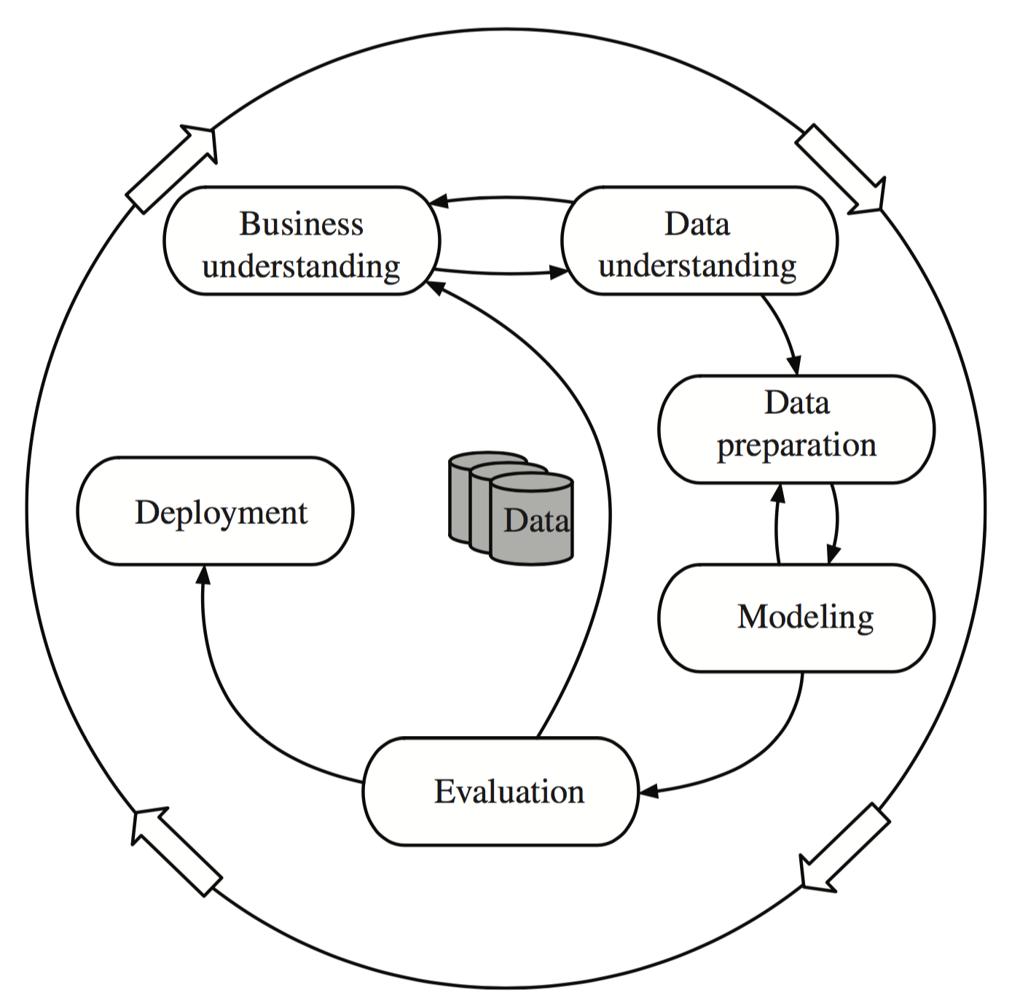
The data mining process

Slide 44
Machine learning and statistics
Historical difference (grossly oversimplified):
Statistics: testing hypotheses
Machine learning: finding the right hypothesis
But: huge overlap
Decision trees (C4.5 and CART)
Nearest-neighbor methods
Today: perspectives have converged
Most machine learning algorithms employ statistical techniques

Slide 45
Generalization as search
Inductive learning: find a concept description that fits the data
Example: rule sets as description language
Enormous, but finite, search space
Simple solution:
enumerate the concept space
eliminate descriptions that do not fit examples
surviving descriptions contain target concept

Slide 46
Enumerating the concept space
Search space for weather problem
4 x 4 x 3 x 3 x 2 = 288 possible combinations
With 14 rules => 2.7x10³⁴ possible rule sets
Other practical problems:
More than one description may survive
No description may survive
Language is unable to describe target concept
or data contains noise
Another view of generalization as search: hill-climbing in description space according to pre-specified matching criterion
Many practical algorithms use heuristic search that cannot guarantee to find the optimum solution

Slide 47
Bias
Important decisions in learning systems:
Concept description language
Order in which the space is searched
Way that overfitting to the particular training data is avoided
These form the “bias” of the search:
Language bias
Search bias
Overfitting-avoidance bias

Slide 48
Language bias
Important question:
is language universal or does it restrict what can be learned?
Universal language can express arbitrary subsets of examples
If language includes logical or (“disjunction”), it is universal
Example: rule sets
Domain knowledge can be used to exclude some concept descriptions a priori from the search

Slide 49
Search bias
Search heuristic
“Greedy” search: performing the best single step
“Beam search”: keeping several alternatives
…
Direction of search
General-to-specific
E.g. specializing a rule by adding conditions
Specific-to-general
E.g. generalizing an individual instance into a rule

Slide 50
Overfitting-avoidance bias
Can be seen as a form of search bias
Modified evaluation criterion
E.g., balancing simplicity and number of errors
Modified search strategy
E.g., pruning (simplifying a description)
Pre-pruning: stops at a simple description before search proceeds to an overly complex one
Post-pruning: generates a complex description first and simplifies it afterwards

Slide 51
Data mining and ethics I
Ethical issues arise in practical applications
Anonymizing data is difficult
85% of Americans can be identified from just zip code, birth date and sex
Data mining often used to discriminate
E.g., loan applications: using some information (e.g., sex, religion, race) is unethical
Ethical situation depends on application
E.g., same information ok in medical application
Attributes may contain problematic information
E.g., area code may correlate with race

Slide 52
Data mining and ethics II
Important questions:
Who is permitted access to the data?
For what purpose was the data collected?
What kind of conclusions can be legitimately drawn from it?
Caveats must be attached to results
Purely statistical arguments are never sufficient!
Are resources put to good use?

Slide 53
Q&A
Thank you. ☺

