Slide 1
Machine Learning
Network Data Science Lab
Seunghun Lee, KangHee Lee
Professor : Hyun-Chul Kim
2018. 06. 04

Slide 2
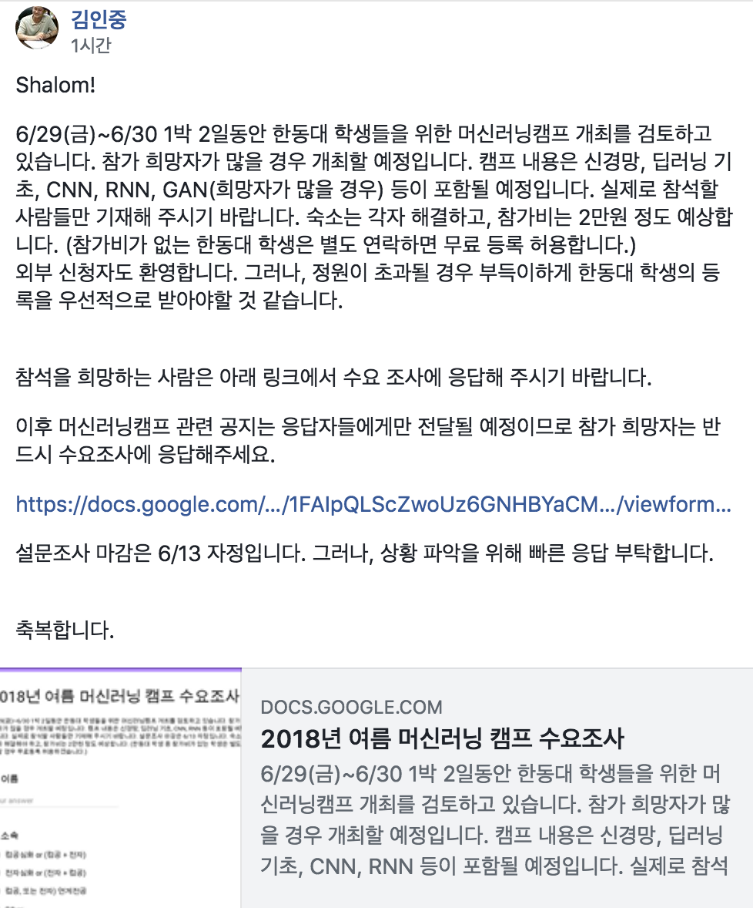
한동대학교 머신러닝 캠프(김인중 교수님)
김인중 교수님 페이스북
https://www.facebook.com/callee2006
https://docs.google.com/forms/d/e/1FAIpQLScZwoUz6GNHBYaCM7biAgQ2QF-_N4_JEoV0oS5kEo4xjPlUOg/viewform

Slide 3
수업 참고 자료
참고 자료 - https://tykimos.github.io/lecture/
모두를 위한 머신러닝/딥러닝 강의 - https://hunkim.github.io/ml/
2/5

Slide 4
Deep learning software
Tensorflow
Deeplearning4j
Keras
Pytorch
Camparison of deep learning software - https://en.wikipedia.org/wiki/Comparison_of_deep_learning_software
3/5

Slide 5
Thank you!!!
5/5

